Slide 1


INTEGRATED PROJECT – SUMMER 2024
Tips for Statement of Work
Team Arocha
Actuarial Science Program
June 6, 2024

Slide 2
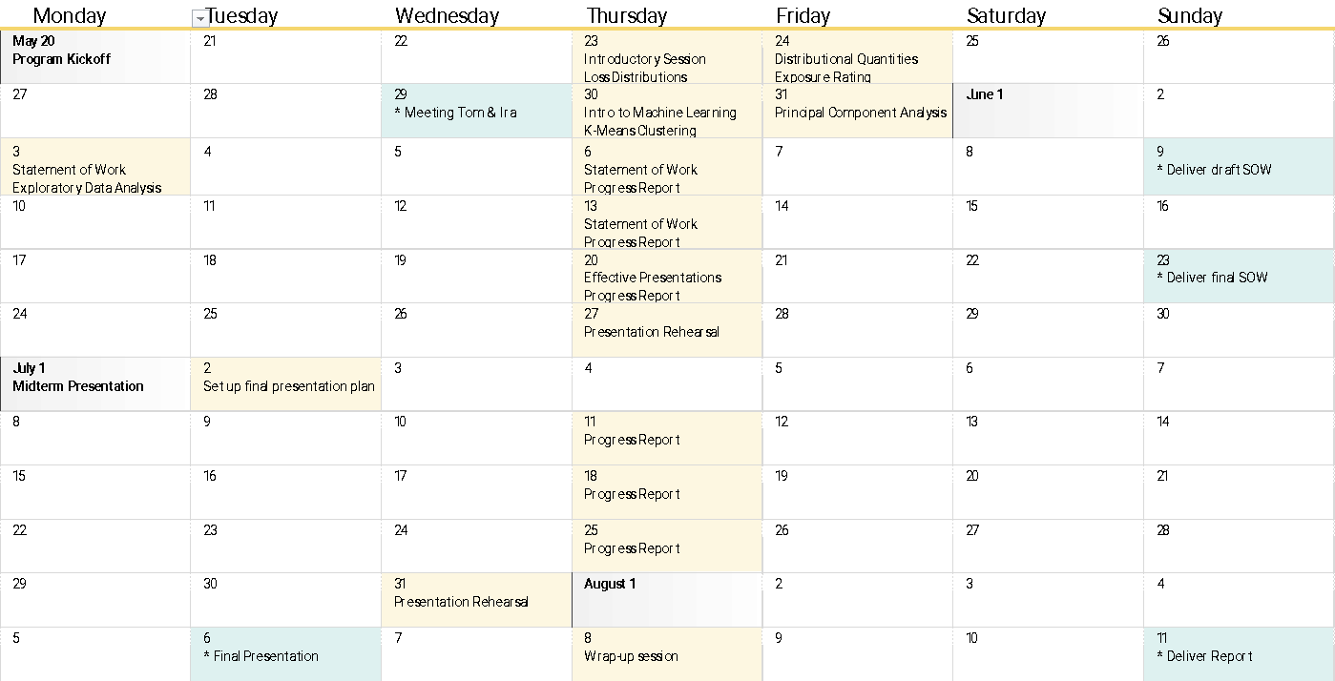

Slide 3
TABLE OF CONTENTS
01 | Best Practice SOW
02 | What is the Problem?

Slide 4
Statement of Work
For the first draft, create a 2—3 page document with the following content
For the final version, include a detailed timetable
Component | Description | Best Practice
Project title | Descriptive name | Make it concise, yet descriptive
List of members and contact information | Contact data of team members, instructors, and mentor | Use a tabular format
Introduction | Business problem that your client wants to solve | 1—2 short paragraphs
Objective | High-level description of project and how will project help the client (i.e., “Columbia Insurance Company”, or CIC) to solve the problem | 2—3 short paragraphs outlining the purpose of the project
Scope of services | List of all major steps that you will perform, including the data that is required from CIC | Bulleted lists: one for the steps, another for the required data
Handling of proprietary information | A statement guaranteeing the confidentiality of the data | Start with “Our consultancy undertakes to maintain stringent secrecy and not to disclose to any third parties, during the lifetime of the project and after the project has ended, any documents or information related to CIC”
Proposed learning outcomes | What will you learn by undertaking this project | Start with “After the successful completion of this project, the members of our team will be able to ...”

Slide 5














What is the Problem?
CURRENT SITUATION
Small insurance company
One property product
Single loss distribution
Aggregate loss modeling /
MC simulation
Losing competitiveness, poor results
NEW SITUATION
Substantial growth in the past five years
Multiple property products
Multiple loss distributions
Alternative pricing methodology
(Exposure Rating)
Want to become profitable (again)

